Slide 1

CS123 Digital Logic Design
LECTURE 20
Asynchronous Counters using D Flip-Flops
Engr.Hammad Munami

Slide 2
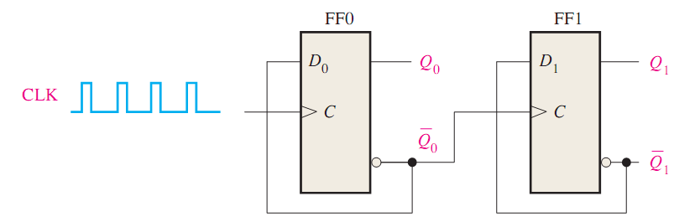
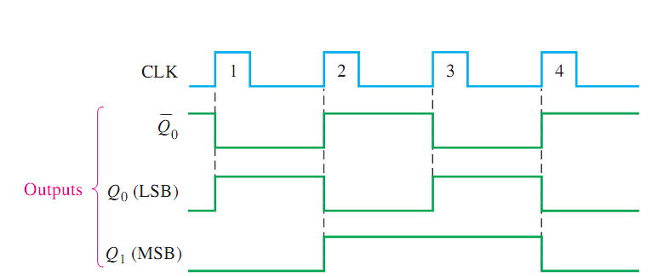
2-Bit Asynchronous Binary Counter
Engr.Hammad Munami

Slide 3
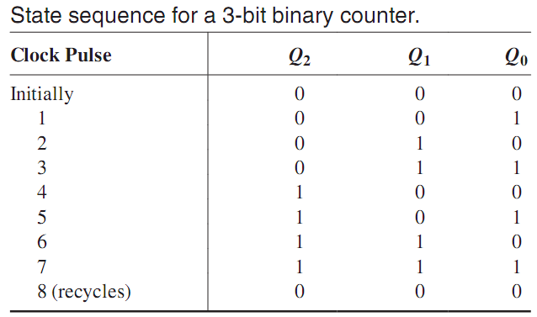
3-Bit Asynchronous Binary Counter
Engr.Hammad Munami

Slide 4
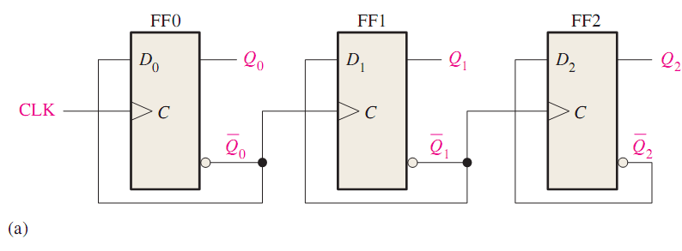
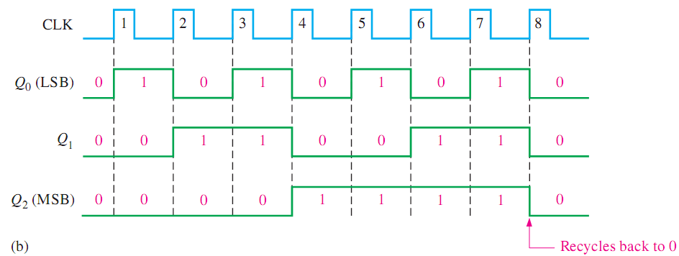
3-Bit Asynchronous Binary Counter
Engr.Hammad Munami

Slide 5
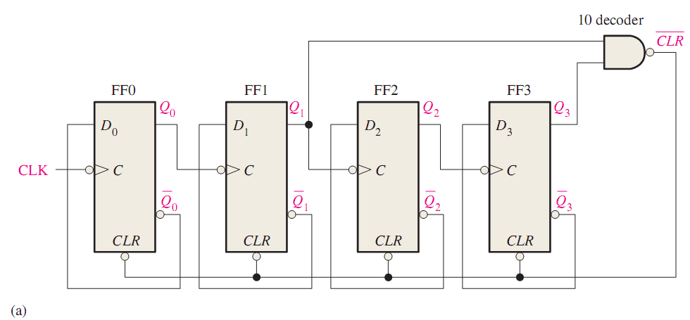
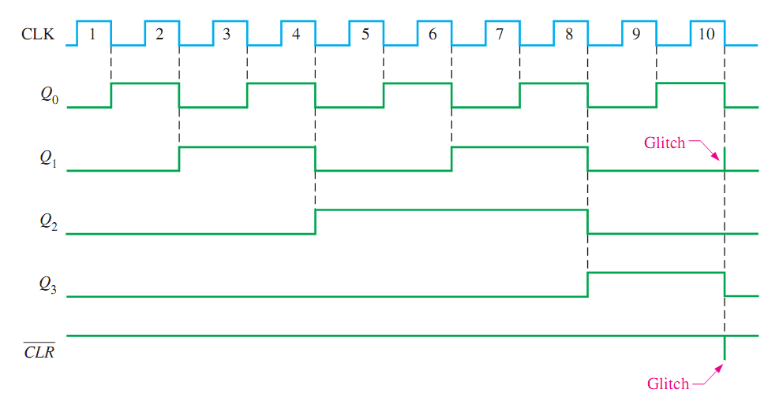
Asynchronous Decade Counters
Engr.Hammad Munami

